Slide 1

Social Capital and Economic Mobility
Raj Chetty*, Matthew Jackson*, Theresa Kuchler*, Johannes Stroebel*
Nathan Hendren, Robert Fluegge, Sara Gong, Federico González, Armelle Grondin Matthew Jacob, Drew Johnston, Martin Koenen, Eduardo Laguna-Muggenburg Florian Mudekereza, Tom Rutter, Nicolaj Thor, Wilbur Townsend, Ruby Zhang Mike Bailey, Pablo Barberá, Monica Bhole & Nils Wernerfelt

Slide 2
What are the Characteristics of High-Upward-Mobility Areas?
Large literature has identified several strong predictors of variation in upward mobility across areas, including:
Lower poverty rates [Chetty, Hendren, Kline, Saez 2014]
School quality [Chetty, Hendren, Kline, Saez 2014]
Income inequality [Corak 2013, Krueger 2012, Durlauf et al. 2022]
Racial segregation, public goods [Cutler and Glaeser 1997, Derenoncourt 2022]
Family structure, father presence [Chetty, Hendren, Jones, Porter 2018]
Violence and crime [Sharkey and Torrats-Espinosa 2017, Manduca and Sampson 2019]
Pollution exposure [Colmer et al. 2021]
Historical redlining [Aaronson et al. 2021]
Potential importance of social capital? [e.g., Putnam 2016]

Slide 3





What is “Social Capital”? Three Concepts from the Prior Literature
Connectedness
Cohesiveness
Civic Engagement
?
?
High-SES
Low-SES
Loury 1977; Bourideu 1986;
Lin and Dumin 1986; Putnam 2016
Coleman 1988; Jackson et al. 2012
Putnam et al. 1994; Putnam 1995; Glaeser, Laibson, Sacerdote 2002

Slide 4


The research: Two Papers
f
Measure Social Capital Using Data from Facebook
Analyze Associations with Economic Mobility
Identify Determinants of Social Connections

Slide 5
Measurement of
Social Capital
Association with Economic Mobility
Determinants of Economic Connectedness
Targeting Interventions
Measuring Social Capital

Slide 6
Data and Sample Definitions
Baseline analysis sample
U.S. Facebook users between ages 25–44 as of May 28, 2022
72.2 million individuals, 21 billion friendships: 84% coverage of 25–44-year-old population

Slide 7
Economic Connectedness
Begin by measuring economic connectedness: to what extent are individuals from low- vs. high-SES backgrounds friends with each other?
Many reasons that economic connectedness might matter for outcomes: information, influence on aspirations and preferences, job referrals [e.g., Case and Katz 1991, Glaeser, Sacerdote, Scheinkman 1996, Cherng, Calarco, Kao 2013, Pallais 2014, Burks et al. 2015, Putnam 2016, …]

Slide 8
Measuring Socioeconomic Status
Construct an index of socioeconomic status (SES) by combining several proxies: ZIP code, college, phone model price, …
Baseline measure: combination that best predicts median household income in block group (available for a subset of users) using a machine learning model
Rank users in the national distribution based on their predicted SES ranks relative to others in their cohort

Slide 9
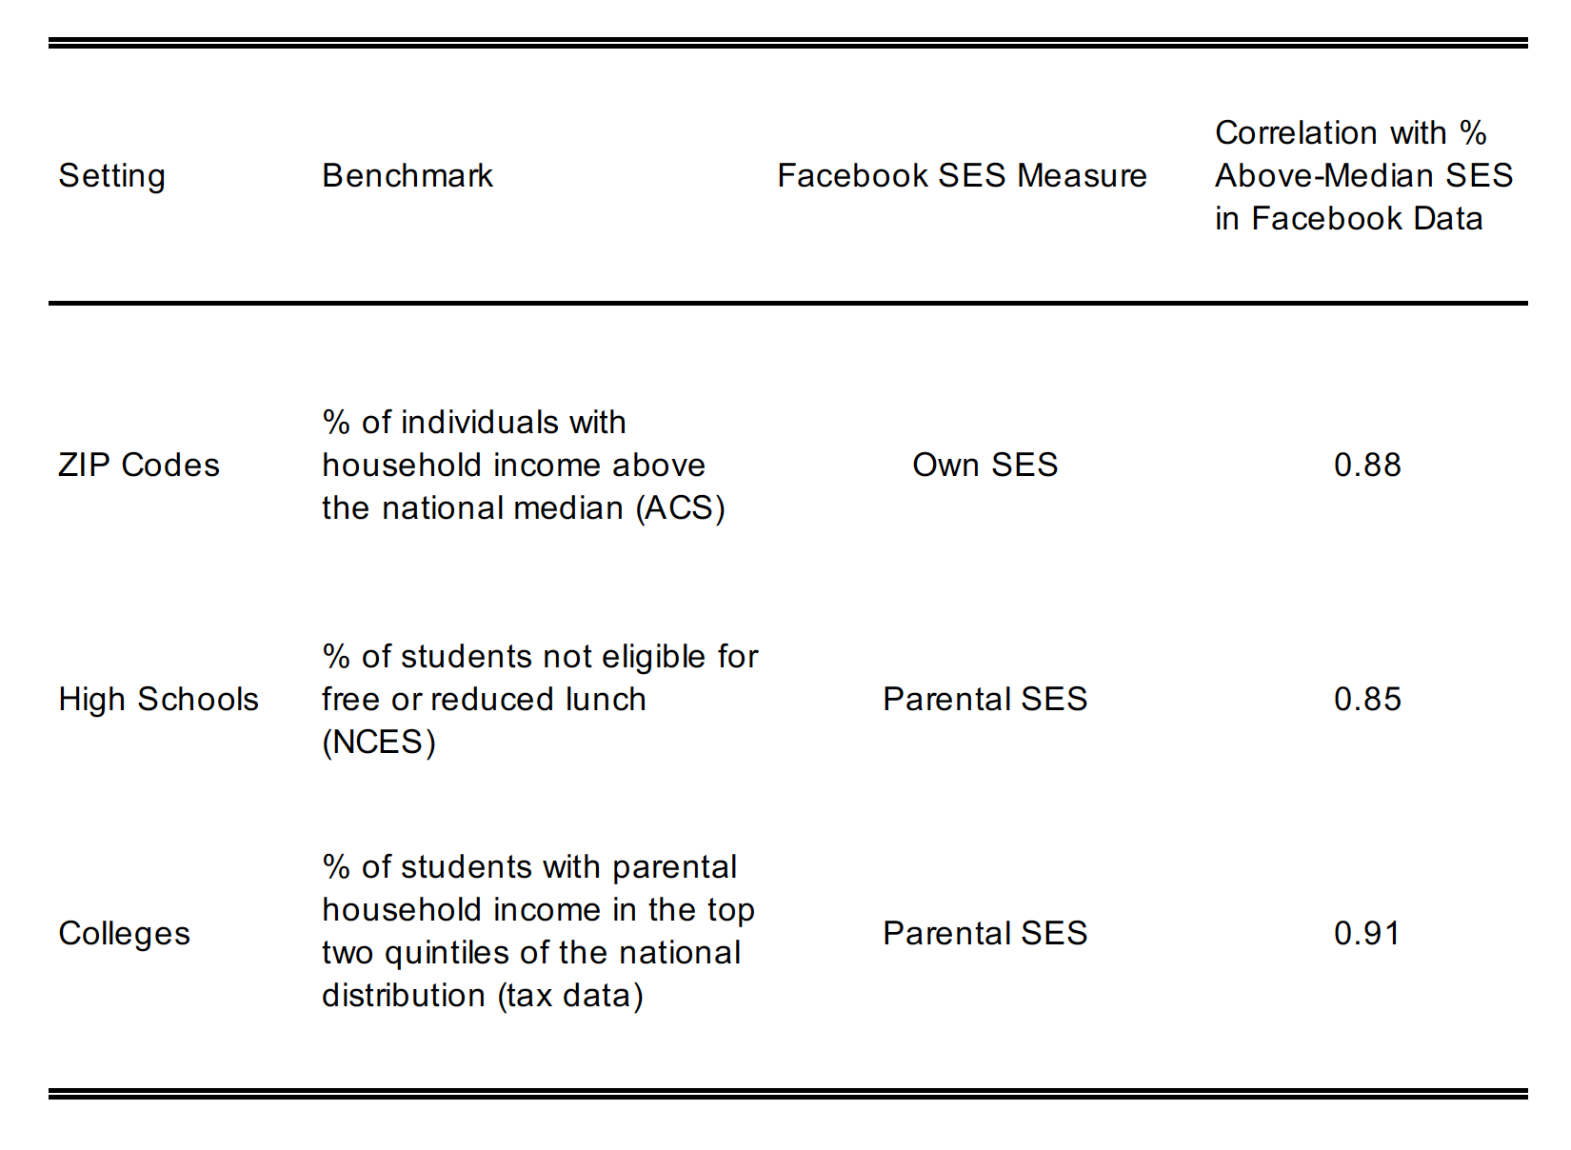
Benchmarking SES Predictions Using Publicly Available Data
Notes:
2-ED-2

Slide 10
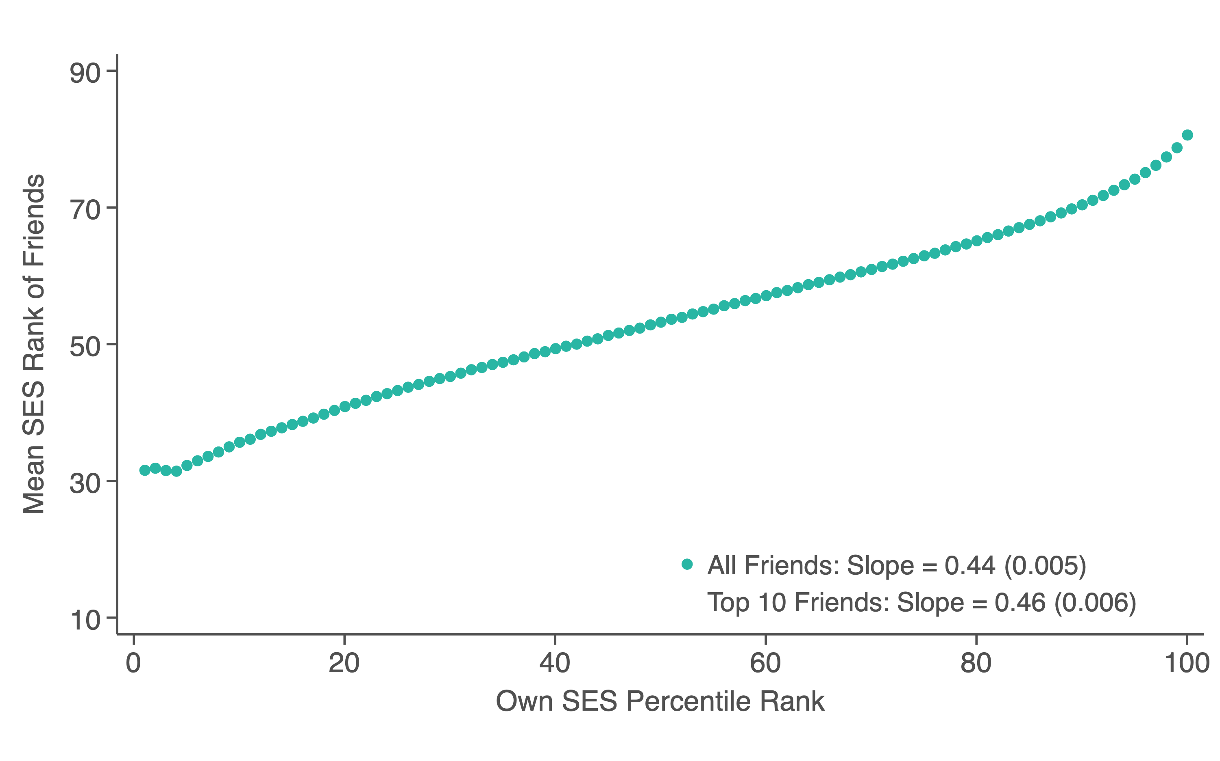
Mean Friend SES Rank vs. Own SES Rank
Notes:
1-1A

Slide 11
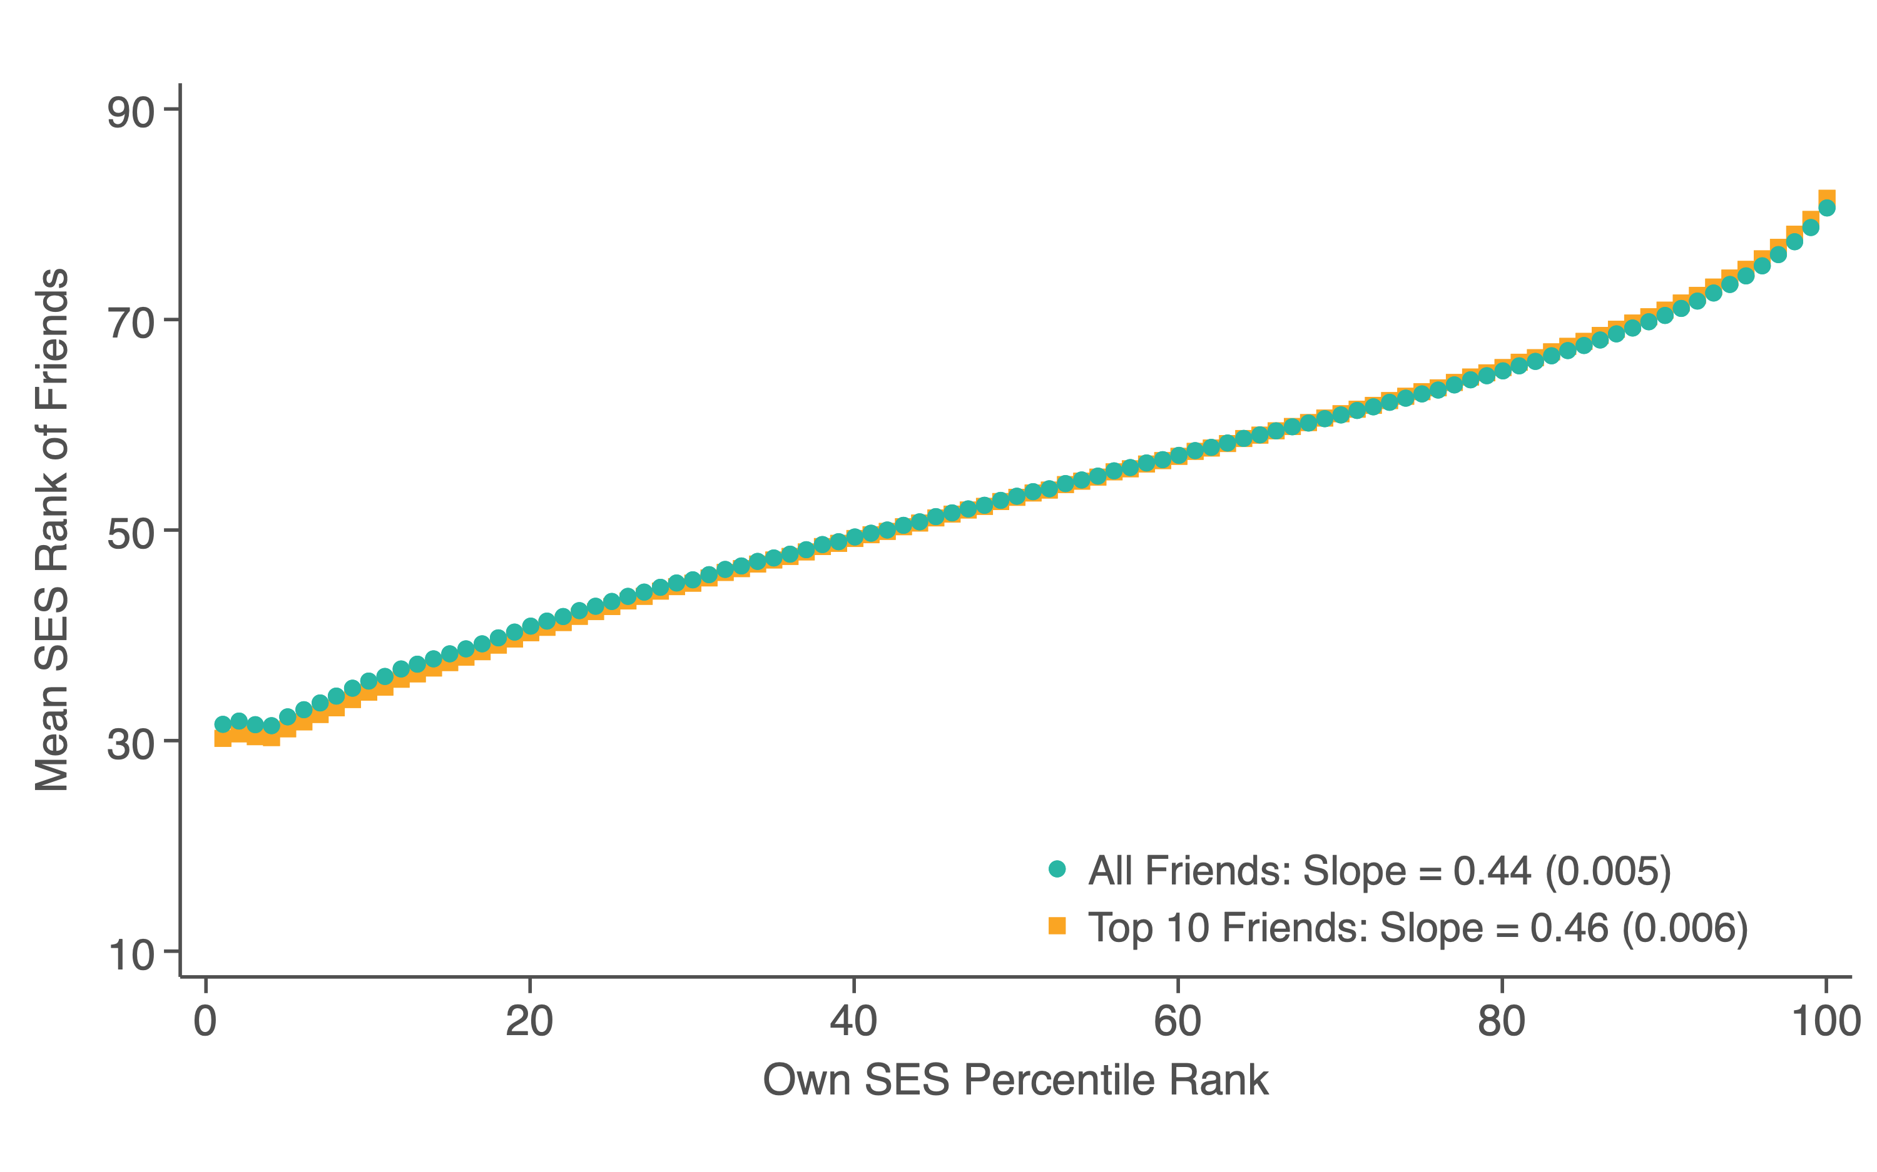
Mean Friend SES Rank vs. Own SES Rank
Notes:
1-1A

Slide 12
Homophily by SES in Facebook Data vs. Add Health Survey Data
Mean Parents Rank of Five Best Friends in High School vs. Own Parents’ Rank
Notes:
1-1B

Slide 13
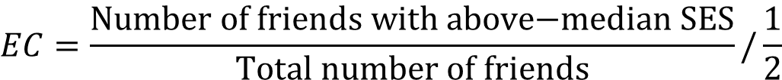
Measuring Economic Connectedness Across Subgroups
Facebook data have sufficiently large samples to allow us to disaggregate across subgroups (ZIP codes, high schools, colleges, etc.)
Summarize the degree to which low-SES people in a given group are connected to high-SES people using the following statistic:
Mean EC nationally = 0.78: 22% under-representation of high-SES friends relative to random-friending benchmark
$$EC=\frac{\text{Number} \text{of} \text{friends} \text{with} \text{above}\text{−}\text{median} \text{SES}}{\text{Total} \text{number} \text{of} \text{friends}}/\frac{1}{2}$$

Slide 14
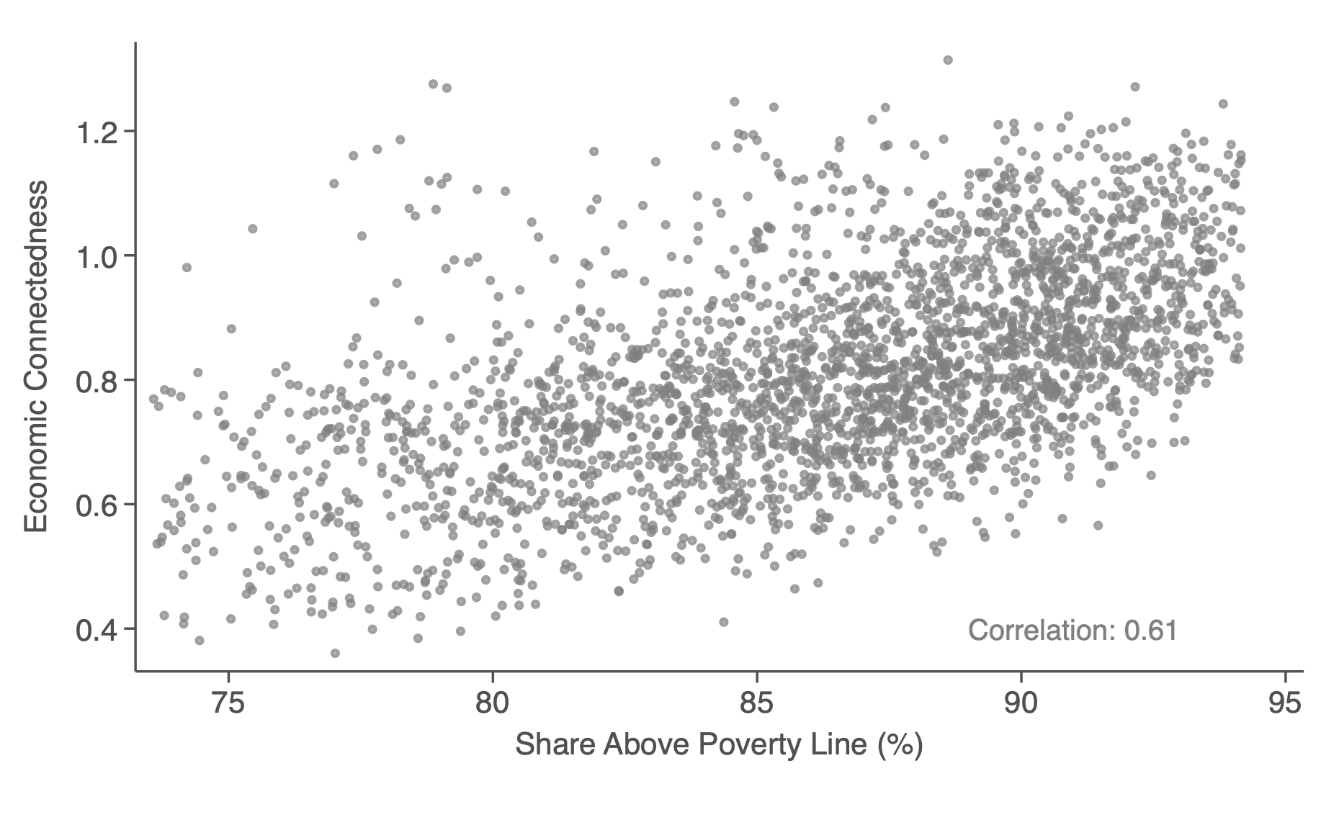
Economic Connectedness vs Share Above Poverty Line, by County

Slide 15
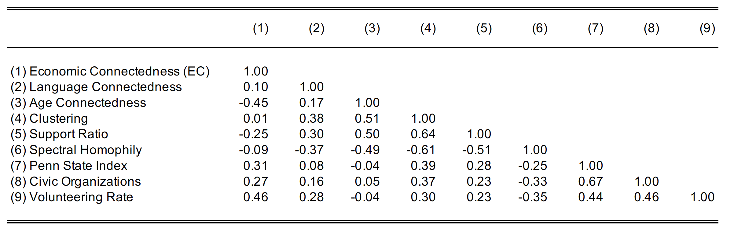
Correlation Matrix of County-Level Social Capital Measures
Notes:
1-1

Slide 16
Measurement of
Social Capital
Association with Economic Mobility
Determinants of Economic Connectedness
Targeting Interventions
Association with Economic Mobility

Slide 17
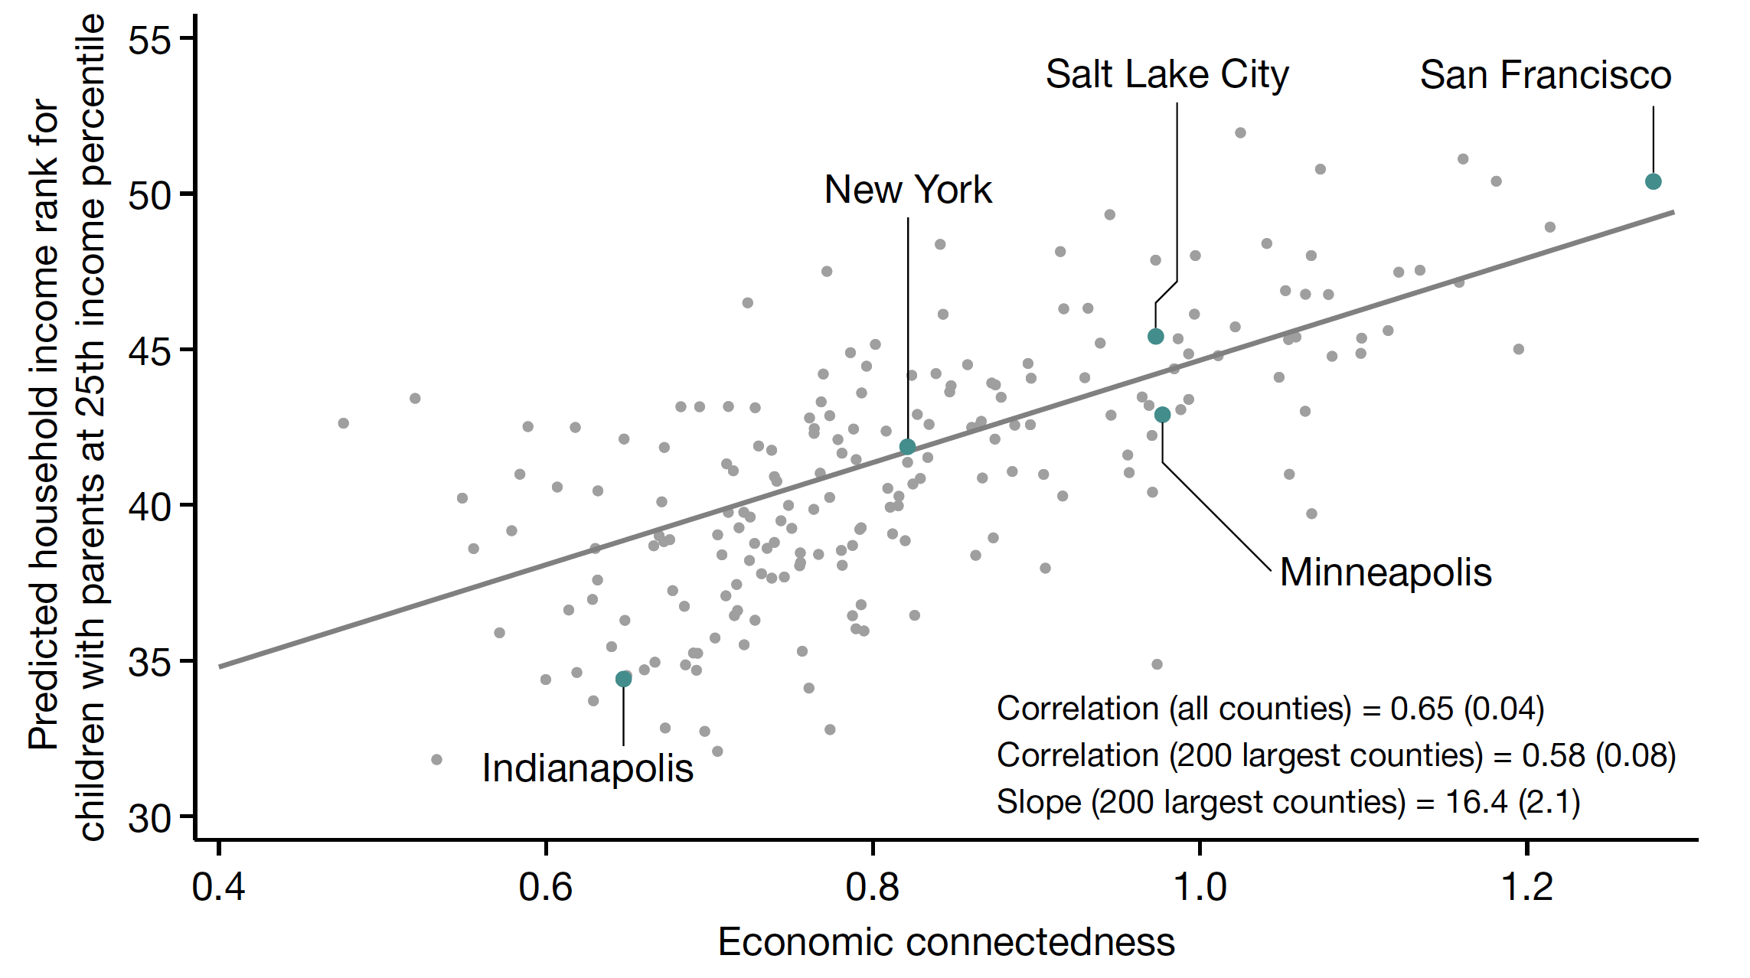
Upward Mobility vs. Economic Connectedness, by County
200 Largest Counties
Notes:
1-4

Slide 18
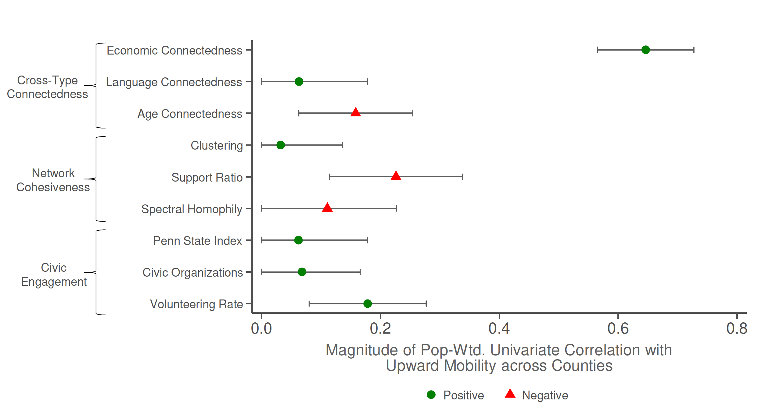
Correlations between Upward Mobility and Measures of Social Capital
County-level Univariate Correlations
Notes:
1-3A

Slide 19
Why is Economic Connectedness Related to Upward Mobility?
Economic connectedness may have a causal effect on upward mobility through many mechanisms (e.g., aspirations, information, referrals)
But EC may be correlated with mobility even in the absence of a causal effect for three other reasons:
Reverse causality: upward mobility leads to higher EC in adulthood
Selection: people who live in high-EC areas differ on other dimensions (e.g., race)
Other neighborhood characteristics: high-EC neighborhoods have other features (e.g., better schools) that generate high upward mobility

Slide 20
Reverse Causality
To address reverse causality, examine friendships made before individuals enter labor market, based on parental SES
Pre-determined relative to ex-post SES, so cannot be mechanically affected by rates of upward mobility
Two approaches to measuring childhood EC: high school friends, parental SES of Facebook users and current day Instagram users aged 13-18
Childhood EC remains strongly correlated with upward mobility
Correlation of 0.44 using Facebook subsample linked to parents and 0.62 using Instagram full sample

Slide 21
Selection vs. Causal Effects
To evaluate importance of selection on other dimensions, examine association between estimated causal effects of counties on upward mobility and EC
Ideal experiment: randomly assign children to different counties while growing up and test if those assigned to counties with higher EC earn more as adults
Instead, use causal effect estimates from Chetty and Hendren (2018), identified using a quasi-experimental movers design
Analyze earnings in adulthood of 7 million children whose parents moved to a different county while they were growing up
Identification assumption: age at move between a given pair of areas is orthogonal to potential outcomes conditional on parental income
Identify causal effect of spending a year of childhood in each county by comparing children who moved that county earlier vs. later [Chetty, Hendren, Katz 2016, Chyn 2018, Deutscher 2019, Alesina et al. 2020, Laliberte 2021]

Slide 22
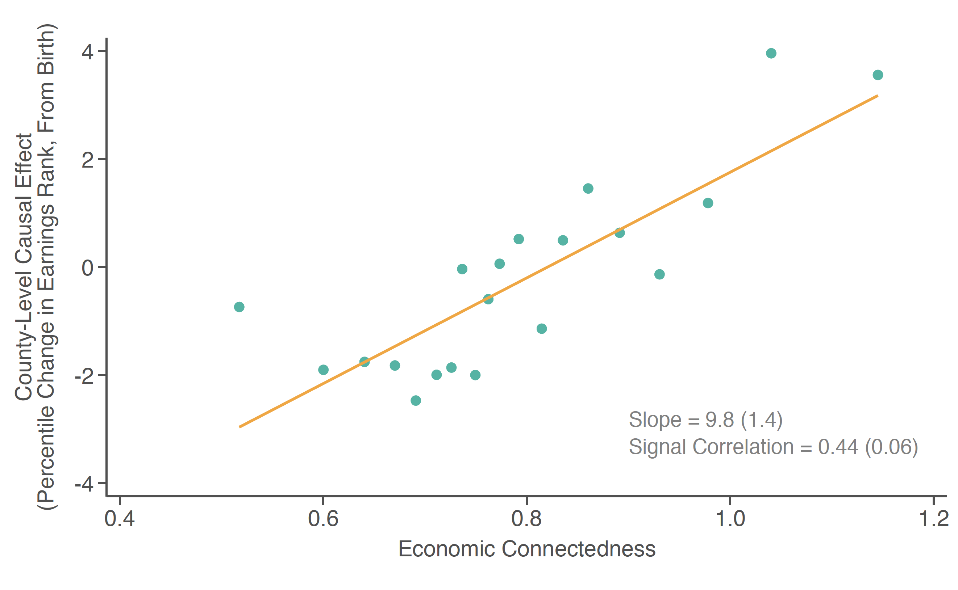
Counties’ Causal Effects on Upward Income Mobility vs. Economic Connectedness
Notes:
1-ED-5
Key implication: moving to a higher-EC county at a younger age during childhood increases children’s earnings in adulthood

Slide 23
Economic Connectedness vs. Other Neighborhood Characteristics
Growing up in a higher-EC area has a causal effect on upward mobility through a childhood exposure effect
Is this because of connectedness itself or other characteristics of high-EC neighborhoods?
Compare explanatory power of strongest predictors identified in prior work (poverty rates, inequality, racial segregation, …) vs. economic connectedness
Start by examining role of average neighborhood incomes, currently the most widely used marker of “high opportunity” areas (e.g., Moving to Opportunity, Opportunity Zones)

Slide 24
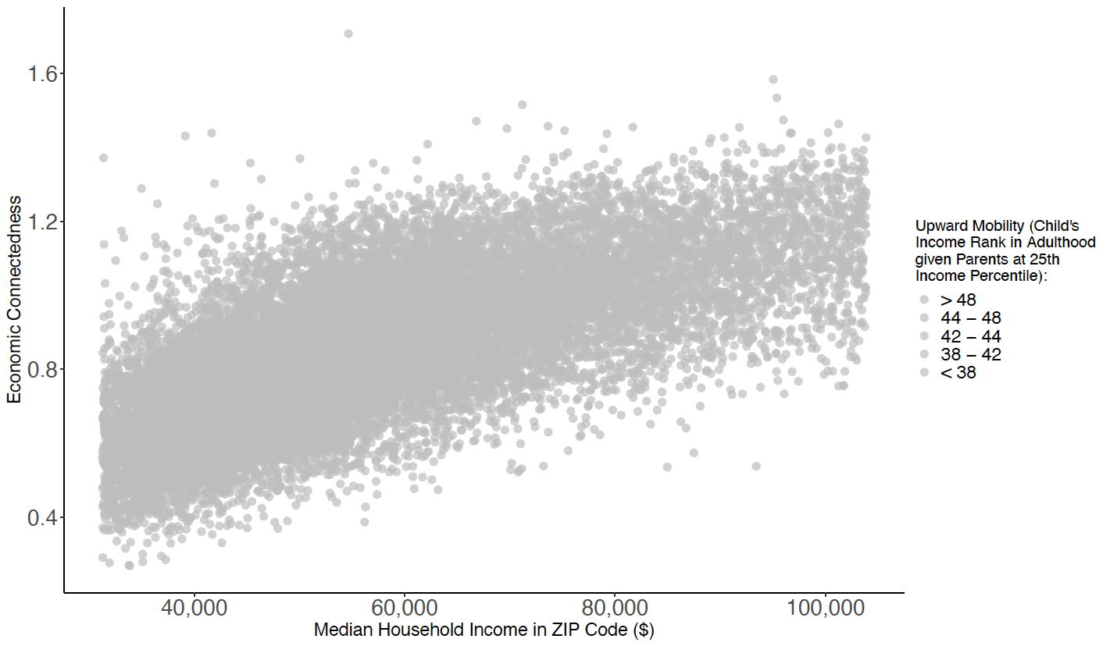
Economic Connectedness vs. Household Median Income, by ZIP Code
Notes:
1-6

Slide 25
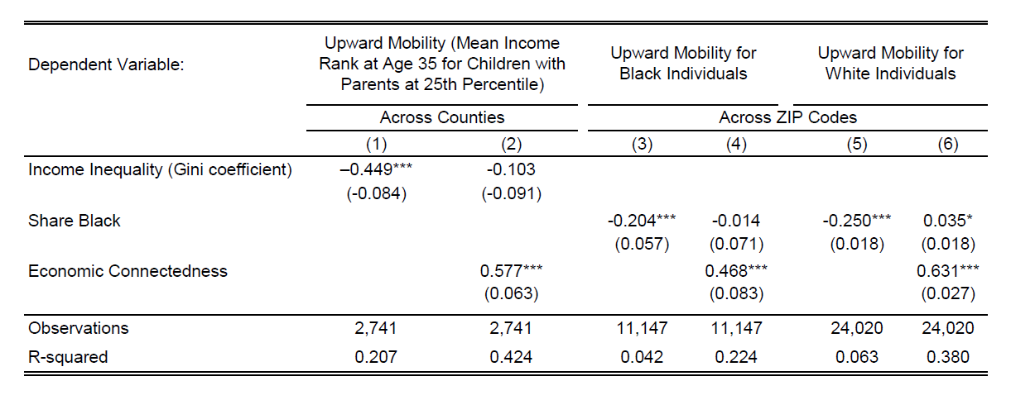
Upward Mobility vs. Economic Connectedness, Inequality, and Segregation OLS Regression Estimates, Across Counties and ZIP codes
Connectedness explains the link between inequality and mobility
(Great Gatsby Curve) [Corak 2013, Krueger 2016]

Slide 26
Upward Mobility vs. Economic Connectedness, Inequality, and Segregation OLS Regression Estimates, Across Counties and ZIP codes
Cutler and Glaeser (1997): “segregation is extremely harmful for blacks, but we do not have an exact understanding of why this is true.”
Lack of connectedness provides a (statistical) explanation

Slide 27
Connectedness and Outcomes for High-SES Families
Greater economic connectedness is strongly associated with better outcomes for low-income families, but does this come at the expense of outcomes for the rich? [see also Rao 2019, Londono-Velez 2022, Burzstyn et al. 2022]

Slide 28
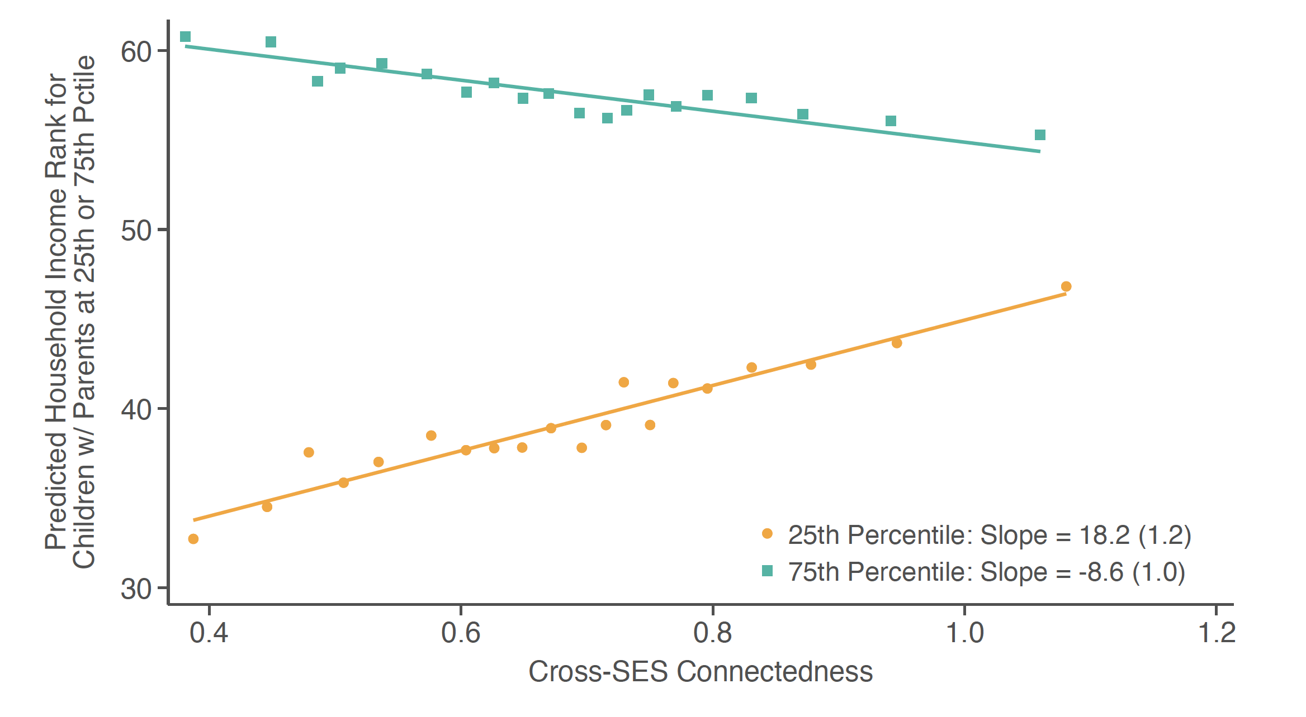
Economic Mobility vs. Cross-SES Connectedness for Low- vs. High-SES Individuals
County-Level
Notes:
1-ED-6A

Slide 29
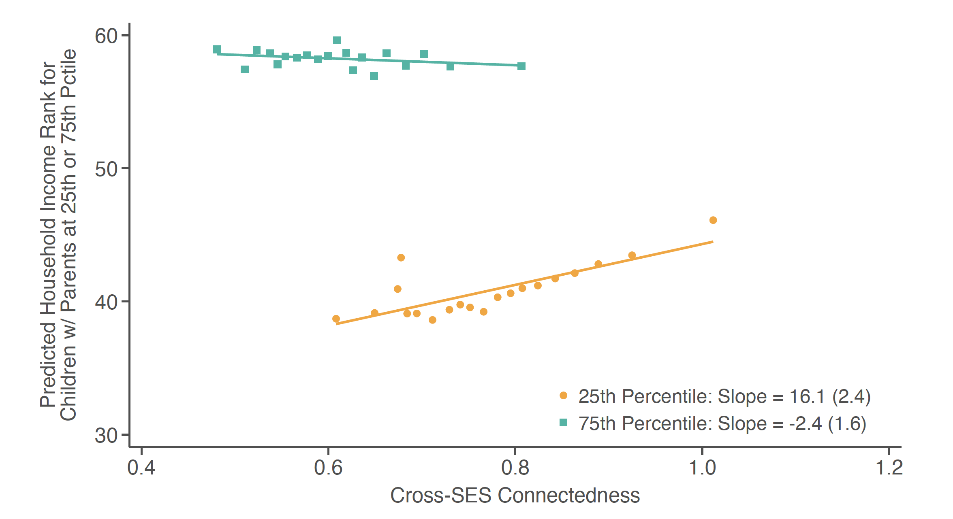
Economic Mobility vs. Cross-SES Connectedness for Low- vs. High-SES Individuals
County-Level, Controlling for Share of High-SES Residents
Notes:
1-ED-6B

